Slide 1
Computer Science
Set Theory and Sequences
Samuel Lukas

Slide 2
Introduction
A set is an unordered collection of objects (elements)
a∈A “a is an element of A”
“a is a member of A”
a∉A “a is not an element of A”
A = {a₁, a₂, …, a_{n}} “A consists of…”
Various relations can exist between sets:
Equality, Subset and Proper Subset

Slide 3
Standard Sets
Natural numbers N = {0, 1, 2, 3, …}
Integers Z = {…, -2, -1, 0, 1, 2, …}
Positive Integers Z⁺ = {1, 2, 3, 4, …}
Real Numbers R = {…,47.3, -12, π, …}
Rational Numbers Q = {1.5, 2.6, -3.8, 15, …}
Q = {a/b | a∈Z ∧ b∈Z+}

Slide 4
Relations between Sets
,
Examples :
{ 1, 2, 3 } = { 2, 2, 3, 1, 2, 3, 3, 1 }

Slide 5
Relations Between Sets
Logical Equivalence rules:
A = B ⇔ (A ⊆ B) ∧ (B ⊆ A)
(A ⊆ B) ∧ (B ⊆ C) ⇒ A ⊆ C (see Venn Diagram)
U
B
C
A

Slide 6
Cardinality
If set S contains n (n ∈ N) distinct elements, then S is a finite set with cardinality n.
A = {Mercedes, BMW, Porsche} |A| = 3
B = {1, {2, 3}, {4, 5}, 6} |B| = 4
E = { x∈N | x ≥ 7000 } E is infinite
C = ∅ |C| = 0

Slide 7
Power Set
The power set of set A is the set P(A) that contains all the subsets of A
2^{A} or P(A) “power set of A”
2^{A} = {B | B ⊆ A} (contains all subsets of A)
Examples :
S = { 1,2,3 } then P(S) = {{},{1},{2},{3},{1,2},{1,3},{2,3},{1,2,3}}

Slide 8
Cartesian Product of sets
The Cartesian product of two sets is:
A×B = {(a, b) | a∈A ∧ b∈B}
Example: A = {x, y}, B = {a, b, c}
A×B = {(x, a), (x, b), (x, c), (y, a), (y, b), (y, c)}
The Cartesian product of two or more sets is defined as:
A₁×A₂×…×A_{n} = {(a₁, a₂, …, a_{n}) | a_{i}∈A_{i} , for i = 1, 2, …, n}
A = {good, bad}, B = {student, prof}
A×B = {(good, student), (good, prof), (bad, student), (bad, prof)}
B×A = {(student, good), (prof, good), (student, bad), (prof, bad)}

Slide 9
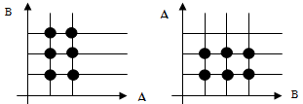
Example 01
A = { 1, 2 }, B = { a,b,c }
A x B = { (1,a), (1,b), (1,c), (2,a), (2,b), (2,c) }
B x A = { (a,1), (a,2), (b,1), (b,2), (c,1), (c,2) }

Slide 10
Set Operation
The Union between two sets A and B (A ∪ B) contains exactly those elements that are either in A or in B, or in both:
A ∪ B = {x | x∈A ∨ x∈B}
Example: A = {a, b}, B = {b, c, d}, A ∪ B = {a, b, c, d}
The Intersection between two sets A and B (A ∩ B) contains exactly those elements that are in both A and B:
A ∩ B = {x | x∈A ∧ x∈B}
Example: A = {a, b}, B = {b, c, d}, A ∩ B = {b}

Slide 11
Set Operation (cont)
The difference between two sets A and B contains exactly those elements of A that are not in B. ( A-B = {x | x∈A ∧ x∉B})
Example: A = {a, b}, B = {b, c, d}, A-B = {a}
Two sets are called disjoint if their intersection is empty, that is, they share no elements: A∩B = ∅.
the complement of a set A is exactly those elements that are in the “universe of discourse” but that are not in A:
A = U - A
Example: U = N, B = {250, 251, …} B^{c} = {0, 1, 2, …, 249}

Slide 12
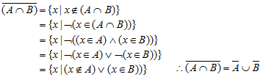

Example 02
Prove : $\overline{(A∩B)}=\overline{A}∪\overline{B}$ and $A∪\left(B∩C\right)=(A∪B)∩(A∪C)$

Slide 13
Functions
A function f from a set A to a set B is an assignment of exactly one element of B to each element of A.
f : A→B
A is the domain of f and B is the codomain of f
If f : A→B, then: the set of all images of elements of A is the range of f or we say that f maps A to B
If f(a) = b, then: b is the image of a & a is the pre-image of b

Slide 14
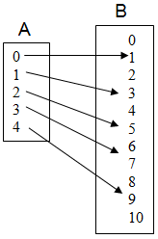
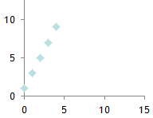
Example 03
$$A=\left\{x | x<5,x∈N\right\}, B=\left\{y | y<11,y∈N\right\} , f\left(x\right)=2x+1$$
Explicit mapping for each element in the domain
Using a formula
Tables, Arrow diagrams
Graphs
f : A→ B = { (0,1), (1,3), (2,5), (3,7), (4,9) }

Slide 15
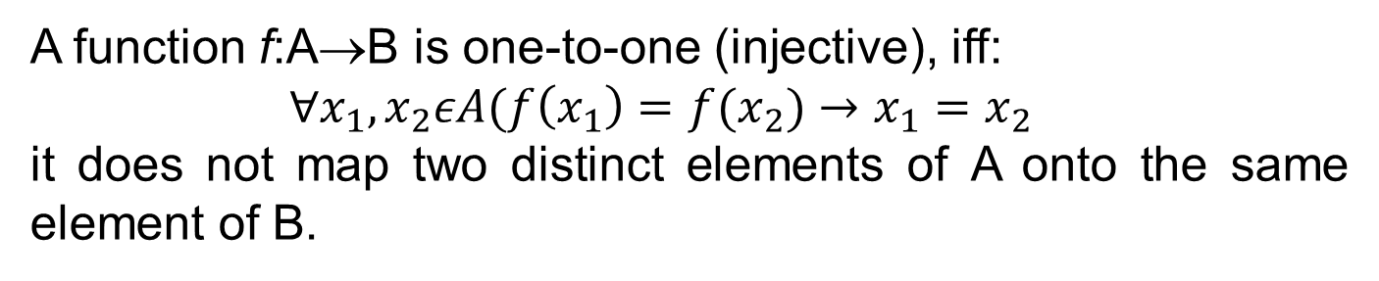
Properties of Functions
A function f:A→B is one-to-one (injective), iff:
$∀x_{1},x_{2}εA(f\left(x_{1}\right)=f(x_{2})→x_{1}=x_{2}$
it does not map two distinct elements of A onto the same element of B.
f : { a,b,c,d } → { 1,2,3,4,5 } dimana f(a) = 4, f(b) = 5, f(c) = 3, dan f(d) = 1
$f:z→z f\left(x\right)=x^{2} is not one to one function$
$f:z^{+}→z^{+} f\left(x\right)=x^{2} is one to one function$

Slide 16
Properties of Functions (cont)
A function f :A→B is onto (surjective), iff ∀b∈B ∃a∈A such that f(a) = b. (“f” is onto iff its range is its entire codomain).
A function f :A→B is one-to-one correspondence (bijection), iff it is both one-to-one and onto
$f:z→z f\left(x\right)=x^{2} is not surjective function$
$f:z^{+}→z^{+} f\left(x\right)=x^{2} is not surjective function$
$f:z→z f\left(x\right)=x+1 is bijection function$

Slide 17
Properties of Functions (cont)
A functions which is a bijection has an inverse function.
The inverse function of the bijection f : A→B is the function f⁻¹: B → A with f⁻¹(b) = a whenever f(a) = b.
Examples:
$$f:z→z f\left(x\right)=x+1 then f:z→z f^{−1}\left(y\right)=y−1$$
$$f:z^{+}→z^{+} f\left(x\right)=x^{2} then{ f}^{−1}:z^{+}→z^{+} f^{−1}\left(y\right)=√y$$

Slide 18
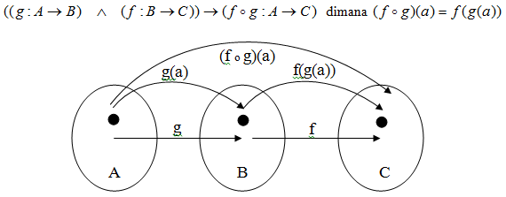
Composition Function
$$f:z→z, f\left(x\right)=2x−3, g\left(x\right)=3x−2 Find \left(f∘g\right)\left(x\right) \& (g∘f)(x)$$
$$\left(f∘g\right)\left(x\right) =f\left(g\left(x\right)\right)=2\left(3x−2\right)−3=6x−7$$
$$\left(g∘f\right)\left(x\right) =g\left(f\left(x\right)\right)=3\left(2x−3\right)−2=6x−11$$

Slide 19
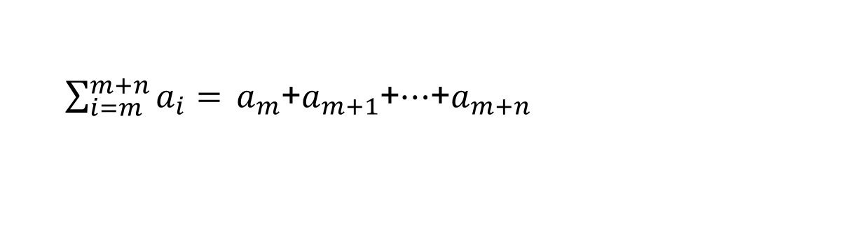
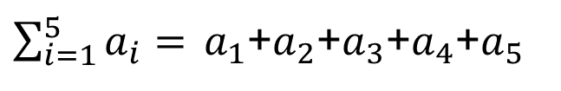
Sequences
Sequences represent ordered sets of elements.
A sequence is a function from a subset of N to a set S. The notation “a_{n”} denotes the image of the integer n. “a_{n”} is called a term of the sequence. It is written as { a_{n} }
$\sum_{i=1}^{5}{a_{i}= }a_{1}$+$a_{2}$+$a_{3}$+$a_{4}$+$a_{5}$
$\sum_{i=m}^{m+n}{a_{i}= }a_{m}$+$a_{m+1}$+$…$+$a_{m+n}$

